Slide 1
G-DLD in AWS cloud platform
For serverless applications

Slide 2
Data Leakage Introduction
Data leakage is a common problem in databases and cloud applications, that involves data from a private source getting exposed.
It is a significant concern for organizations that rely on serverless computing as it can lead to reputational damage, legal consequences, and financial losses.
So far, there is no real solution for detection, only best-practice for prevention.

Slide 3
Research Question
Can we detect data leakage generically in serverless applications?
How long it would take to discover a data leakage if such event happens?
What are the signs of data leakage in serverless application?
Where should we look for the trails of a leakage?
What are the generic data points that are similar for data leakage attacks?

Slide 4
Research Goal
Detection of data leakage generically in the serverless environment of the AWS cloud.

Slide 5
Related Work
Amazon GuardDuty: Amazon GuardDuty is a threat detection service that uses machine learning to identify and alert you to potential security threats in your AWS environment.
Data Leakage Detection and Prevention: Review and Research Directions - Suvendu Kumar Nayak and Ananta Charan Ojha.

Slide 6
Data Leakage Prevention
DLP Methods:
Access Control and Auditing: Access control and auditing mechanisms can be used to monitor and track user activity within the cloud environment, including access to sensitive data. This can help detect any unauthorized attempts to access or download sensitive data.
Encryption: Encryption can be used to protect sensitive data from being read or accessed by unauthorized users. By encrypting data at rest and in transit, data leakage can be prevented or minimized.
Network Traffic Analysis: Network traffic analysis tools can be used to monitor network traffic and identify any suspicious data transfers or patterns that may indicate data leakage.
Behavioral Analysis: Behavioral analysis tools can be used to monitor user behavior and detect any unusual activity that may indicate data leakage. This can include monitoring login attempts, file access, and data transfers.

Slide 7
Vulnerabilities – function focus
Function attacks: function parameters being exploited
Operating System (OS) command injection
Function runtime code injection (e.g. Node.js/JavaScript, Python, Java, C#, Golang)
SQL/ NoSQL injection
Pub/Sub Message Data Tampering (e.g. MQTT data injection)
Object deserialization attacks
XML External Entity (XXE)
Server-Side Request Forgery (SSRF)

Slide 8
Vulnerabilities – policy focus
Broken authentication: exploit open API’s, public access storages, or general external resources. (For example, the execution of internal functionality without authentication is possible if a function is triggered by administrative emails)
In our work, the attacks are a combination of the policy abuse and code changes.

Slide 9
AWS Security and access - Policy
{
"Version": "2012-10-17",
"Id": "ExamplePolicy01",
"Statement": [
{
"Sid": "ExampleStatement01",
"Effect": "Allow",
"Principal": {
"AWS": "arn:aws:iam::123456789012:user/Dave"
},
"Action": [
"s3:GetObject",
"s3:GetBucketLocation",
"s3:ListBucket"
],
"Resource": [
"arn:aws:s3:::awsexamplebucket1/*",
"arn:aws:s3:::awsexamplebucket?/"
]
}
]
}
A S3 policy for an example- notice how the user is the object and the bucket is the subject of the permissions.
Effect: how it would affect the permission. (allow/deny)
Principal: who\what get the policy’s permissions.
Action: what operations are affected. (all permissions are implicitly denied by default)
Resource: on what objects the operations could be used.

Slide 10
Method Model - Features
Year | Month | Day | Hour | Minute | Second | Millisecond
Chronological features
roleName | targetName | targetType
Objects context features
operationUsed | readOnly | Change_s3 | Change_DynamoDB | Remove_policy | anomaly
Permission features

Slide 11
Proposed Methods – Additional features for future work
Errors: access denied, error codes, etc…
Bytes transferred and direction(extracted data or inserted data)
VPC
IP and user agent, depends on level of infiltration
Policy context and initiator of change
Specific policy changes
Statistics for lambda class in a time window
Permission matrix inside nodes for higher resolution

Slide 12
Model Architecture
The current model is composed of a Label Encoder labeling the features.
an isolation forest .
And a decision function for statistical analysis .
Label Encoder
Isolation Forest
Decision Function

Slide 13
Dataset metadata
Training set: 15113
Test set: 3779
99.8% benign activity
0.2% anomalous activity
Data is taken from an experiment we did on the airlines application in December. The data logs the activity of API storage_calls and the changes in permissions.

Slide 14
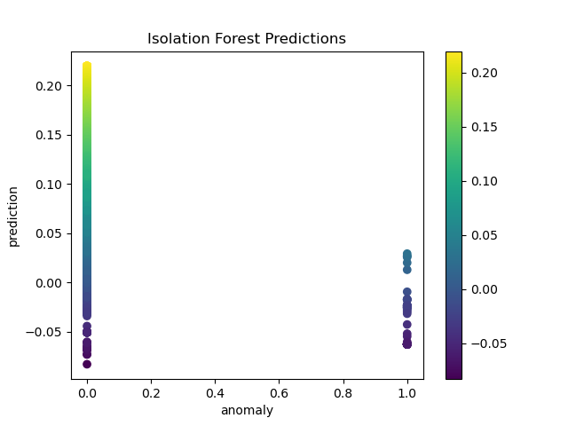
Model
The graph represents the anomaly score for each of the operations.
Closer to 1 on the Y axis, is more anomalous, and 0.5 is normal distribution.
In this instance there were 0.2% anomalies in the data and 99.8% regular traffic.

Slide 15
Model – work in progress
We need to add features in order to increase the information gain from each row from the logs.
The type of the model is not chosen yet, we explore the isolation forest type model as it seems a good fit, but it may change in the future.

Slide 16
Challenges
Finding an attack in the data may prove to be complicated, as there are many ways to the same goal, and many goals that achieve the same end result.
We need to implement more attacks in order to detect a broader range of anomalies in different data.

Slide 17
Expected Results
The model will highlight the anomalous actions as an outlier.
We could detect the leakage even before it happens by recognizing the attack pattern.
The model would work on any application as it would be generic.

